Slide 1
Shell Function
Dr. Abhishek Bhattacharya

Slide 2
Creating Functions
function_name ()
{
list of commands
}

Slide 3
Function Call
Hello ()
{
echo "Hello World" }
# Invoke your function
Hello

Slide 4
Pass Parameters to a Function
You can define a function that will accept parameters while calling the function. These parameters would be represented by $1, $2 and so on.
Hello ()
{
echo "Hello World $1 $2"
}
# Invoke your function
Hello Zara Ali

Slide 5
Returning Values from Functions
If you execute an exit command from inside a function, its effect is not only to terminate execution of the function but also of the shell program that called the function.
If you instead want to just terminate execution of the function, then there is way to come out of a defined function.
Based on the situation you can return any value from your function using the return command whose syntax is as follows −
return c

Slide 6
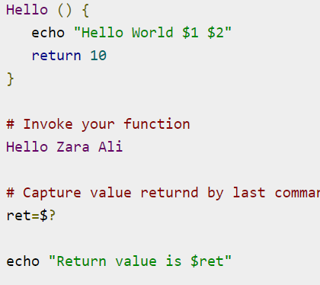

Slide 7
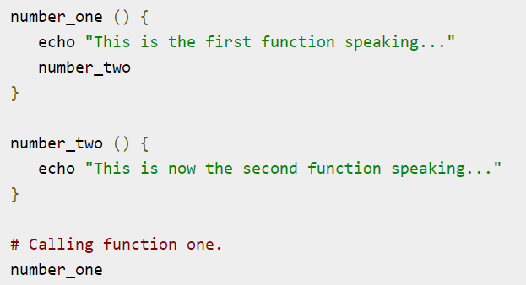
Nested Function call

Slide 8
Scope
The variables in bash are global by default and accessible from anywhere, including function bodies. Variables defined inside a function are also global.

Slide 9
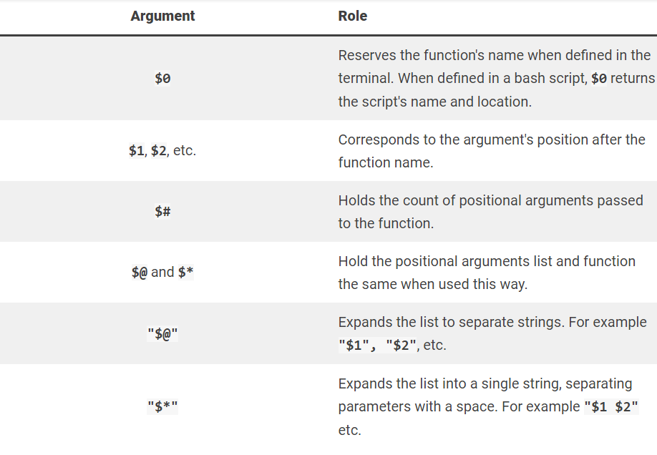
Bash Function Arguments

Slide 10
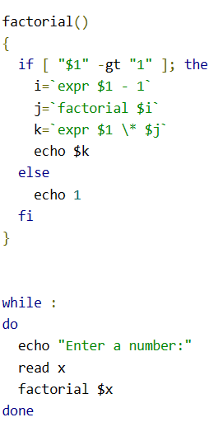
Recursion

